Slide 1
Risk-Aware Privacy Budget Allocation for GAN-Based Synthetic Data Generation
    Presented by
    PAVITHA P
    PRABAVATHI S
    RAGASUDHA B
Guided By
Dr .R.HARINE RAJASHREE

Slide 2
Presentation Overview
Title, Domain, Subdomain
Introduction
Literature Survey Progress
System Analysis Progress
Objective
Stakeholder Analysis Insights
Problem Statement
Existing System Implementation
Communication & Visuals (Gantt Chart)
SDG Relevance
References

Slide 3
Domain:
Primary Domain: Data Privacy / Data Security Interdisciplinary Domain: Artificial Intelligence (Machine Learning)
Sub-Domain:
Differential Privacy (DP)
Generative Adversarial Networks (GANs)
Synthetic Data Generation
Privacy-Preserving Machine Learning (PPML)

Slide 4
Introduction
Organizations increasingly need to share sensitive tabular data (financial, medical, behavioral) for research, testing, and AI model training but sharing raw data risks exposing real individuals.
Synthetic data generation solves this by learning patterns from real data and generating artificial records that behave statistically the same, without containing any real person's actual information.
Generative Adversarial Networks (GANs) e.g., CTGAN, DP-CTGAN are among the most widely used methods for generating realistic synthetic tabular data.
To formally guarantee privacy, these methods apply Differential Privacy (DP): deliberately adding calibrated noise during training so no single record can be reliably identified in the output.
The problem: current DP-GAN methods add the same amount of noise to every column, regardless of whether that column is actually risky (e.g., a unique ID-like field) or safe (e.g., a yes/no flag) wasting privacy budget and unnecessarily hurting data quality.
The problem: Current DP-GAN methods add the same amount of noise to every column, regardless of whether that column is actually risky (e.g., a unique ID-like field) or safe (e.g., a yes/no flag) wasting privacy budget and unnecessarily hurting data quality.

Slide 5
Literature Survey Progress
GAN MODELS
TABLE GAN
CTGAN
CTBGAN
Coupla GAN
VAE Models
Transformer Based Models
GPT
BERT
T5
TabTransformer FT-Transformer
GReaT
REaLTab
TabMT
Survey Paper: comparative synthesis

Slide 6
System Analysis Progress
Surveying various synthetic data generation methods, including GANs, VAEs, Transformers, Bayesian Networks, and statistical methods.
Studied existing synthetic data generation techniques.
Compared their contributions, limitations and evaluation methods.
5
1
3
2
4
Analyzed GAN-based models: CTGAN, CTAB-GAN, CTAB-GAN+, GANBLR and MEG.
Reviewed recent healthcare applications of GAN-based synthetic data generation.

Slide 7


Objective
Primary Objective
Design a GAN-based synthetic data generator that allocates differential privacy budget per-column, based on each column's real re-identification risk not uniformly.
Specific Objectives
Compute a per-column attack-risk score (uniqueness, sensitivity, known attack susceptibility)
Modify DP-CTGAN so noise is weighted by that risk score
Benchmark against uniform-noise baselines — fidelity, privacy leakage, utility
Test whether risk-aware allocation beats uniform noise at equal privacy

Slide 8
Stakeholder Analysis
Patients
Primary Stakeholders — Demand absolute privacy and ethical data use.
Researchers
Secondary Stakeholders — Require high-fidelity data for accurate medical discoveries.
Regulatory Bodies
Tertiary Stakeholders — Ensure compliance with HIPAA and the AI Act.
Hospital IT
Operational Stakeholders — Need seamless, scalable data-sharing pipelines.

Slide 9
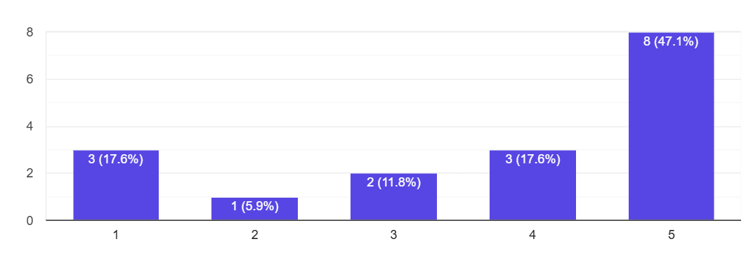
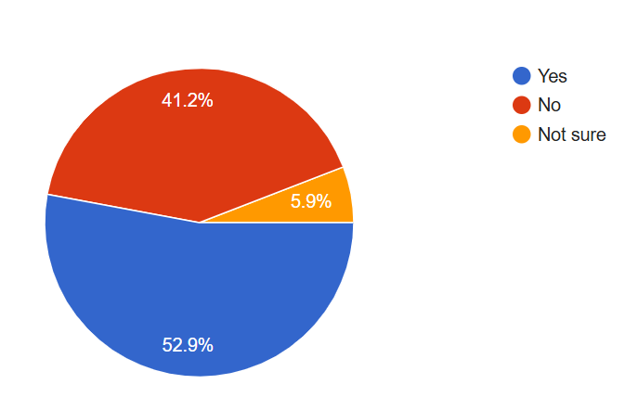
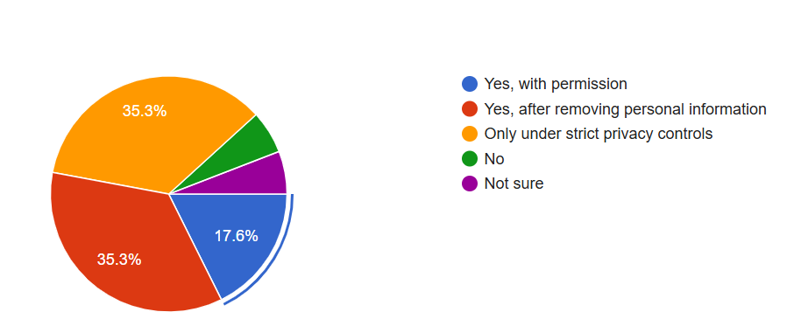
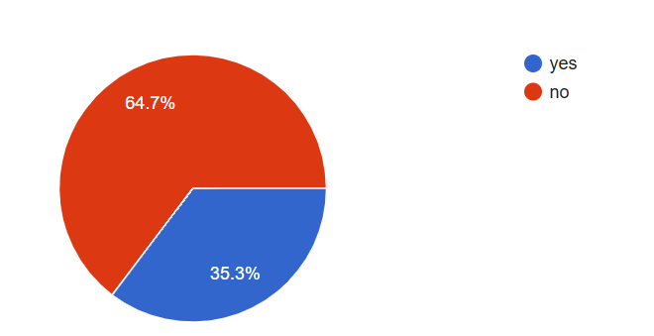
Stakeholder Analysis
1.Have you heard about healthcare data privacy before? 2. How important do you think protecting patient medical data is?
3.Have you heard of synthetic data? 4. Do you think hospitals should be allowed to share patient data withresearchers?

Slide 10
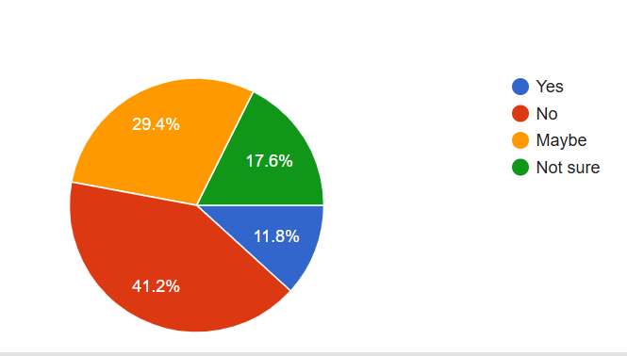
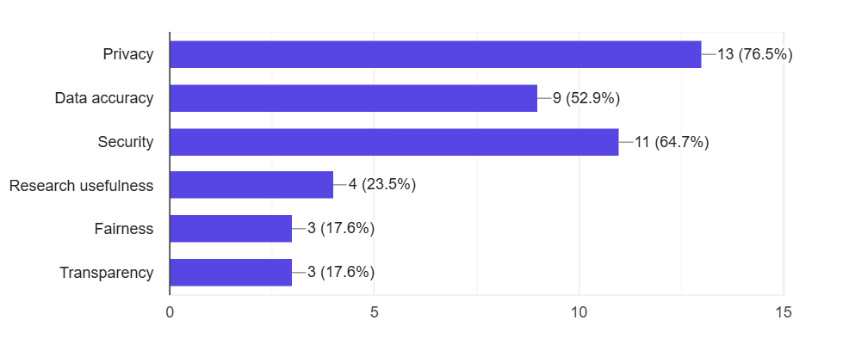
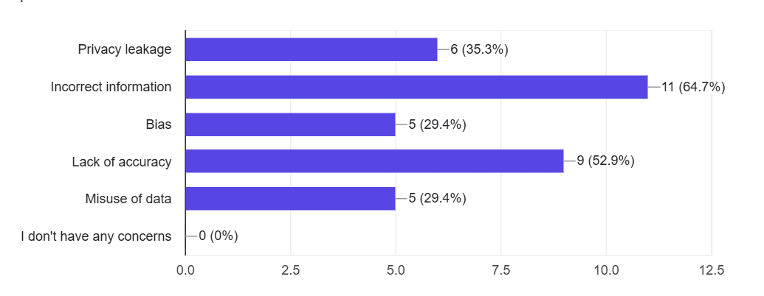
Stakeholder Analysis
5.Would you trust artificially generated healthcare data for research? 6. Which is more important when using healthcare data?
7.If synthetic data doesnot contain real world
entities,would you be more comfortable? 8. What concerns would you have about synthetic healthcare data?

Slide 11
Problem Statement
Current synthetic data methods suffer from the Uniformity Paradox: applying identical privacy protection across heterogeneous healthcare attributes causes unnecessary clinical data distortion for low-risk features while failing to secure high-risk rare patient records.
Over-Protection
Low-risk fields (e.g., zip code) receive excessive noise, destroying clinical utility.
Under-Protection
High-risk rare patient records remain exposed to re-identification attacks.

Slide 12
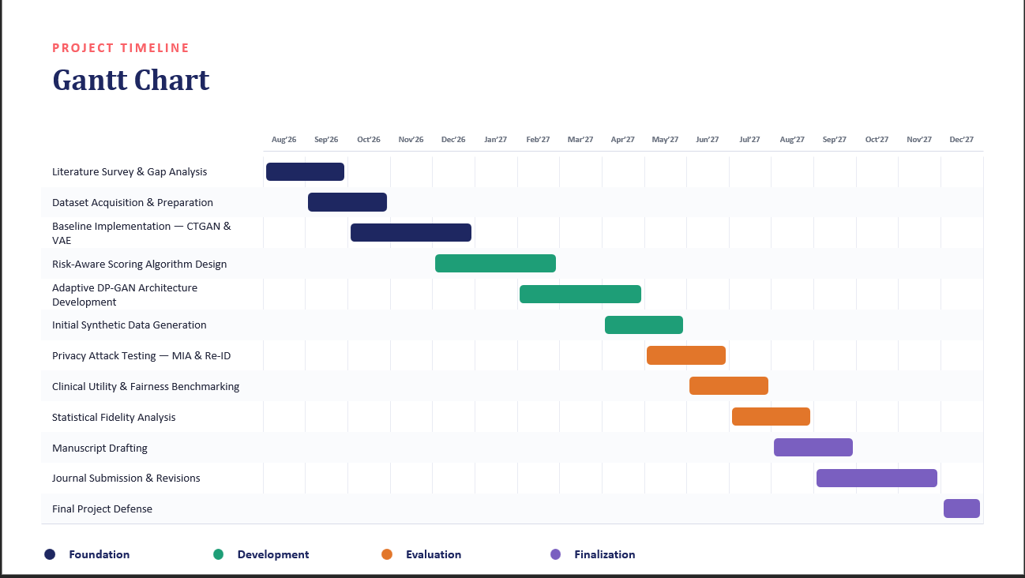

Slide 13


Relevance to Sustainable Development Goals
SDG 3 — Good Health & Well-being
Our Contribution:
Privacy-preserving synthetic healthcare data can support medical research and AI
development while reducing the risk of exposing sensitive patient information.
Impact:
Safer healthcare data sharing
SDG 9 — Industry, Innovation & Infrastructure
Our Contribution:
Our proposed risk-aware privacy approach contributes to secure and responsible
AI-driven data-sharing infrastructure.
Impact:
Supports secure data-sharing systems

Slide 14
Key References
Lyu et al. (2024)
Edge-DPSDG: Edge-based Differential Privacy for Smart Healthcare.
Appenzeller et al. (2022)
Privacy and Utility of Private Synthetic Data.
Zhu et al. (2023)
Generating synthetic mixed-type longitudinal EHR datasets.
Xu et al. (2025)
TableDiffusion: A Diffusion-Based Framework for Tabular Synthesis.
Rankin, D. et al. (2020)
Reliability of Supervised Machine Learning Using Synthetic Data in Health Care: Model to Preserve Privacy for Data Sharing.

Slide 15
Thank You!!!

